Slide 1

Weighted Double Q-Learning
Zhuoyu Wang
Department of Epidemiology and Biostatistics McGill University

Slide 2

An issue with Q-Learning
Q-Learning:
$E\left(\max_{a}{Q\left(S_{t+1},a\right)}\right)≥\max_{a}{E(Q\left(S_{t+1},a\right))}$
Q-Learning ➔ Overestimation.

Slide 3
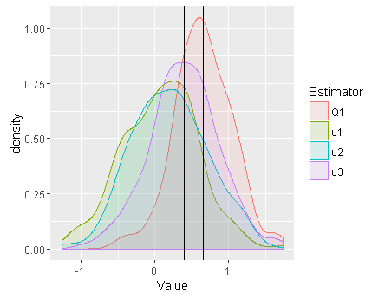

Maximum Expected Value - Illustration
X₁~N($μ_{1}$=0, 5), X₂~N($μ_{2}$=0.2, 5), X₃~N($μ_{3}$=0.3, 5)
$max⁡(μ_{1},μ_{2},μ_{3})$=0.3
$\hat{μ_{i}}=\frac{1}{100}(X_{i1}+…+X_{i100})$ is unbiased.
$Q_{1}=max⁡(\hat{μ_{1}},\hat{μ_{2}},\hat{μ_{3}})$
Repeat 200 times, get distribution of $Q_{1}$.
E(Q1)
0.3

Slide 4
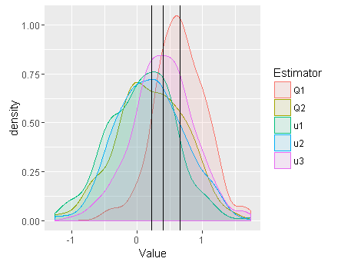
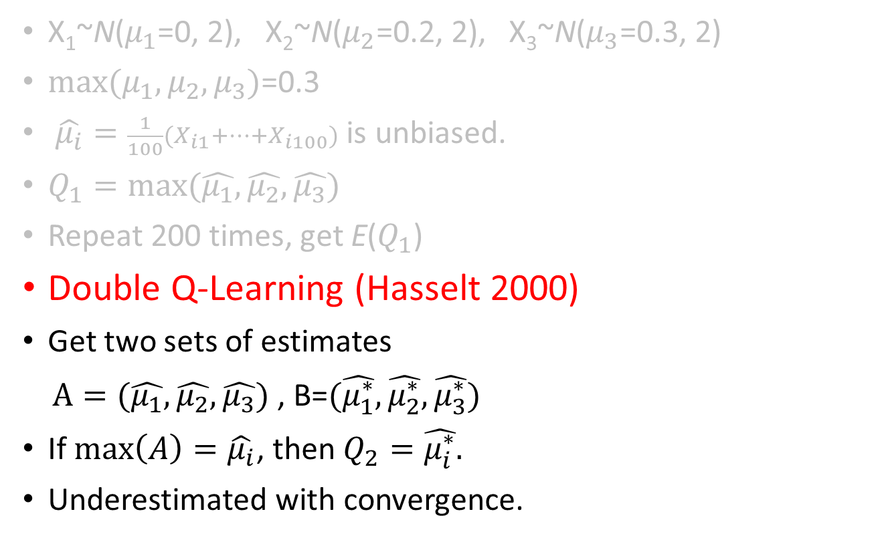
Maximum Expected Value - Illustration
X₁~N($μ_{1}$=0, 2), X₂~N($μ_{2}$=0.2, 2), X₃~N($μ_{3}$=0.3, 2)
$max⁡(μ_{1},μ_{2},μ_{3})$=0.3
$\hat{μ_{i}}=\frac{1}{100}(X_{i1}+…+X_{i100})$ is unbiased.
$Q_{1}=max⁡(\hat{μ_{1}},\hat{μ_{2}},\hat{μ_{3}})$
Repeat 200 times, get E($Q_{1}$)
Double Q-Learning (Hasselt 2000)
Get two sets of estimates
$A=(\hat{μ_{1}},\hat{μ_{2}},\hat{μ_{3}})$ , B=$(\hat{μ_{1}^{∗}},\hat{μ_{2}^{∗}},\hat{μ_{3}^{∗}})$
If $\max\left(A\right)=\hat{μ_{i}}$, then $Q_{2}=\hat{μ_{i}^{∗}}.$
Underestimated with convergence.
E(Q2)
E(Q1)
0.3

Slide 5
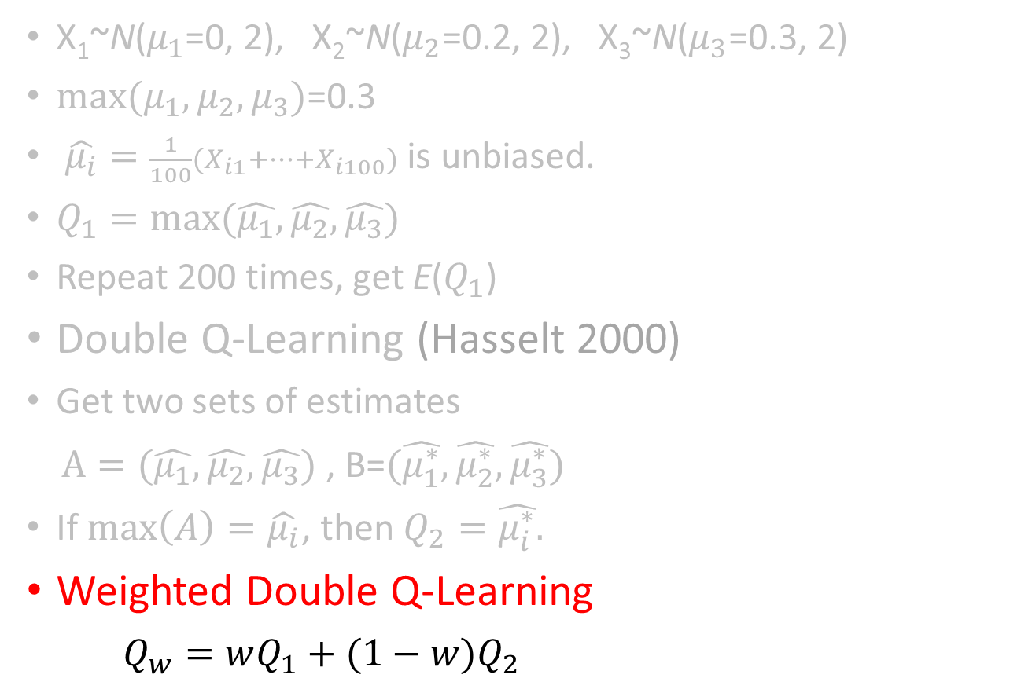
Maximum Expected Value - Illustration
X₁~N($μ_{1}$=0, 2), X₂~N($μ_{2}$=0.2, 2), X₃~N($μ_{3}$=0.3, 2)
$max⁡(μ_{1},μ_{2},μ_{3})$=0.3
$\hat{μ_{i}}=\frac{1}{100}(X_{i1}+…+X_{i100})$ is unbiased.
$Q_{1}=max⁡(\hat{μ_{1}},\hat{μ_{2}},\hat{μ_{3}})$
Repeat 200 times, get E($Q_{1}$)
Double Q-Learning (Hasselt 2000)
Get two sets of estimates
$A=(\hat{μ_{1}},\hat{μ_{2}},\hat{μ_{3}})$ , B=$(\hat{μ_{1}^{∗}},\hat{μ_{2}^{∗}},\hat{μ_{3}^{∗}})$
If $\max\left(A\right)=\hat{μ_{i}}$, then $Q_{2}=\hat{μ_{i}^{∗}}.$
Weighted Double Q-Learning
$Q_{w}=wQ_{1}+(1−w)Q_{2}$
E(Q2)
E(Q1)
Convergence to optimal policy.
0.3

Slide 6
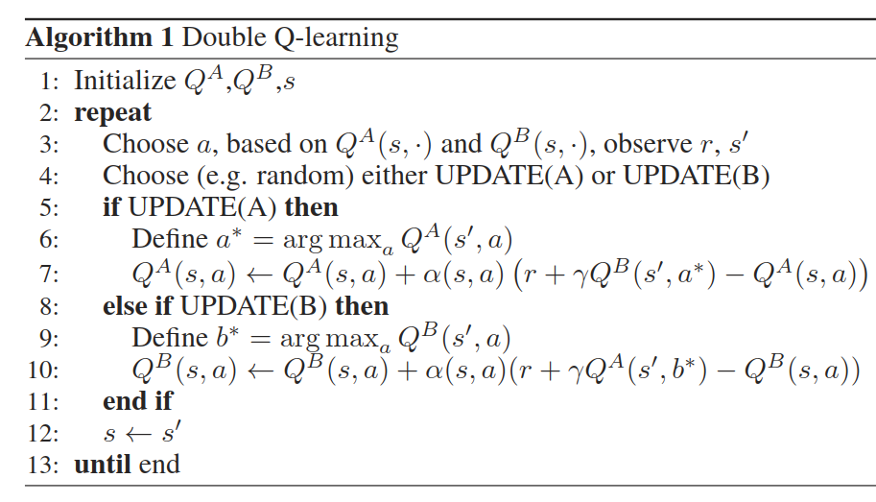
From HV Hasselt, Double Q-Learning, NIPS 2010

Slide 7
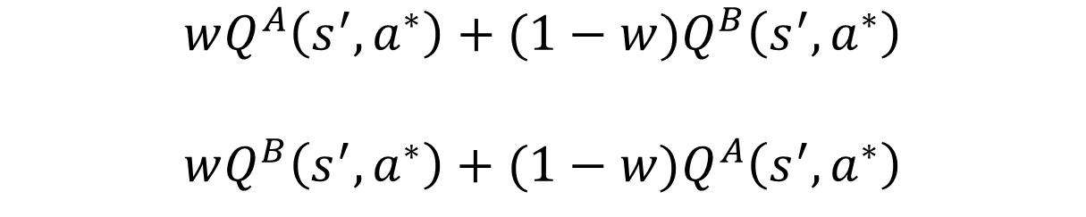
$$wQ^{A}\left(s^{′},a^{∗}\right)+(1−w)Q^{B}\left(s^{′},a^{∗}\right)$$
$$wQ^{B}\left(s^{′},a^{∗}\right)+(1−w)Q^{A}\left(s^{′},a^{∗}\right)$$

Slide 8
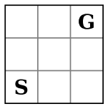
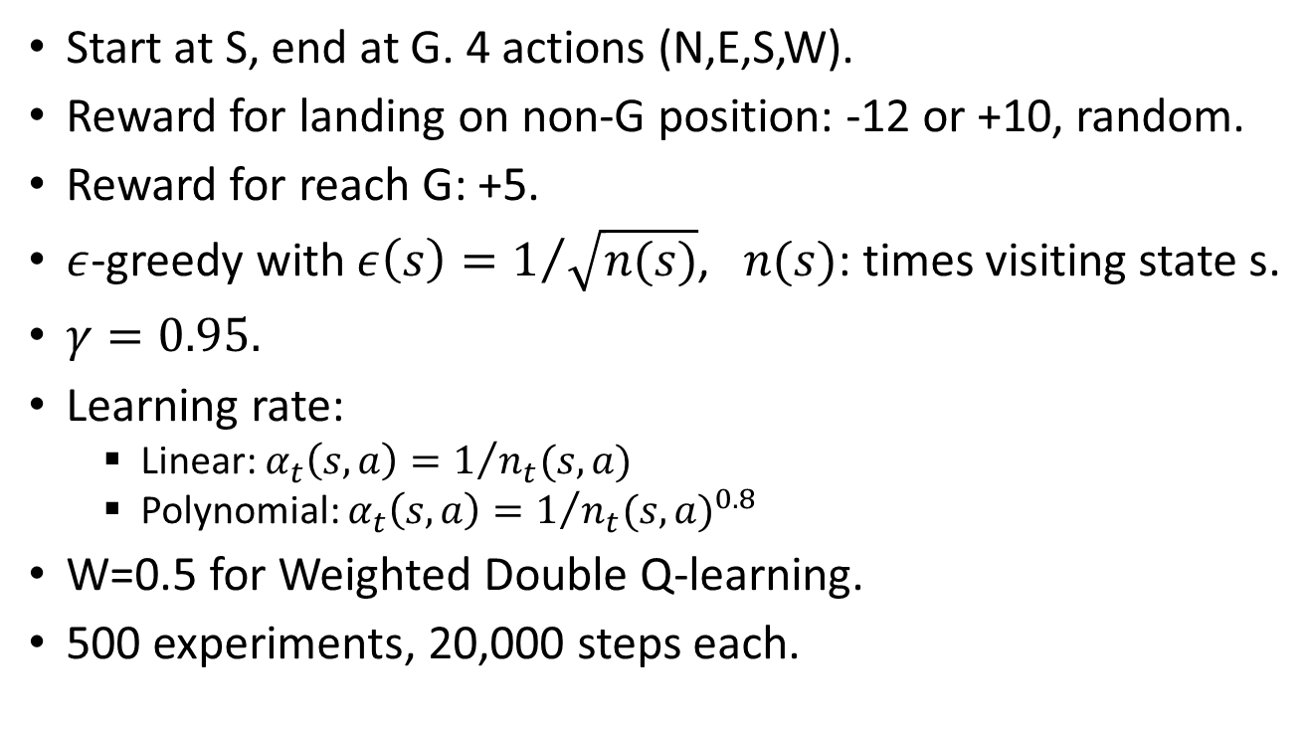
Experiment - Grid World
Start at S, end at G. 4 actions (N,E,S,W).
Reward for landing on non-G position: -12 or +10, random.
Reward for reach G: +5.
$ε$-greedy with $ε\left(s\right)=1/{\sqrt{n(s)}}$, $n(s)$: times visiting state s.
$γ=0.95.$
Learning rate:
Linear: $α_{t}\left(s,a\right)=1/{n_{t}(s,a)}$
Polynomial: $α_{t}\left(s,a\right)=1/{{n_{t}(s,a)}^{0.8}}$
W=0.5 for Weighted Double Q-learning.
500 experiments, 20,000 steps each.
From HV Hasselt, Double Q-Learning, NIPS 2010

Slide 9
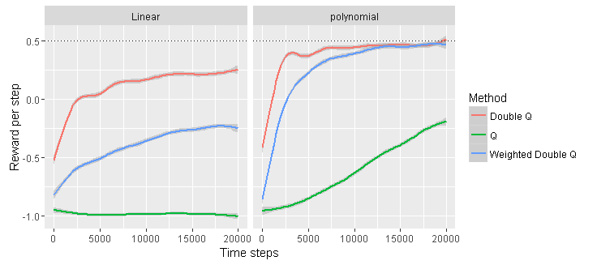
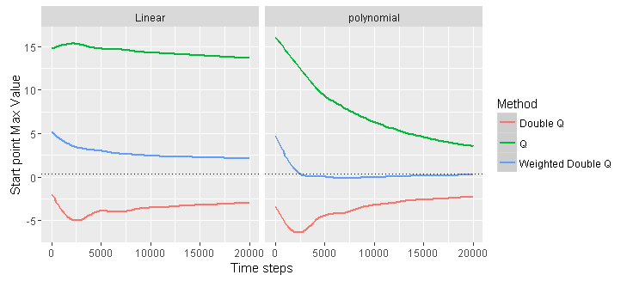

Slide 10
Conclusion
We constructed the new Weighted Double Q-learning algorithm.
Weighted Double Q-learning could speed up convergence in some applications.
Further investigation about how to choose of the weight to obtain faster convergence.
Further work: Weighted Double DQN (Deep Q-Networks).

Slide 11
The End!

